Slide 1
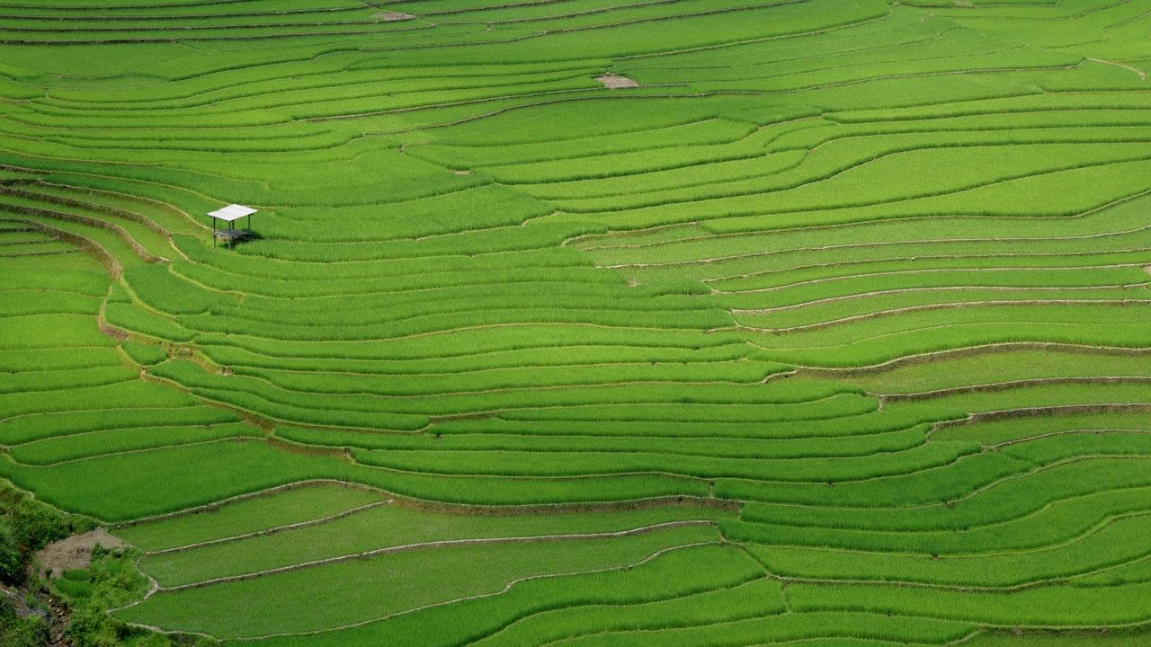
Kishan Bandhu

Slide 2

Hello!
We are Team ZeroBug

Slide 3
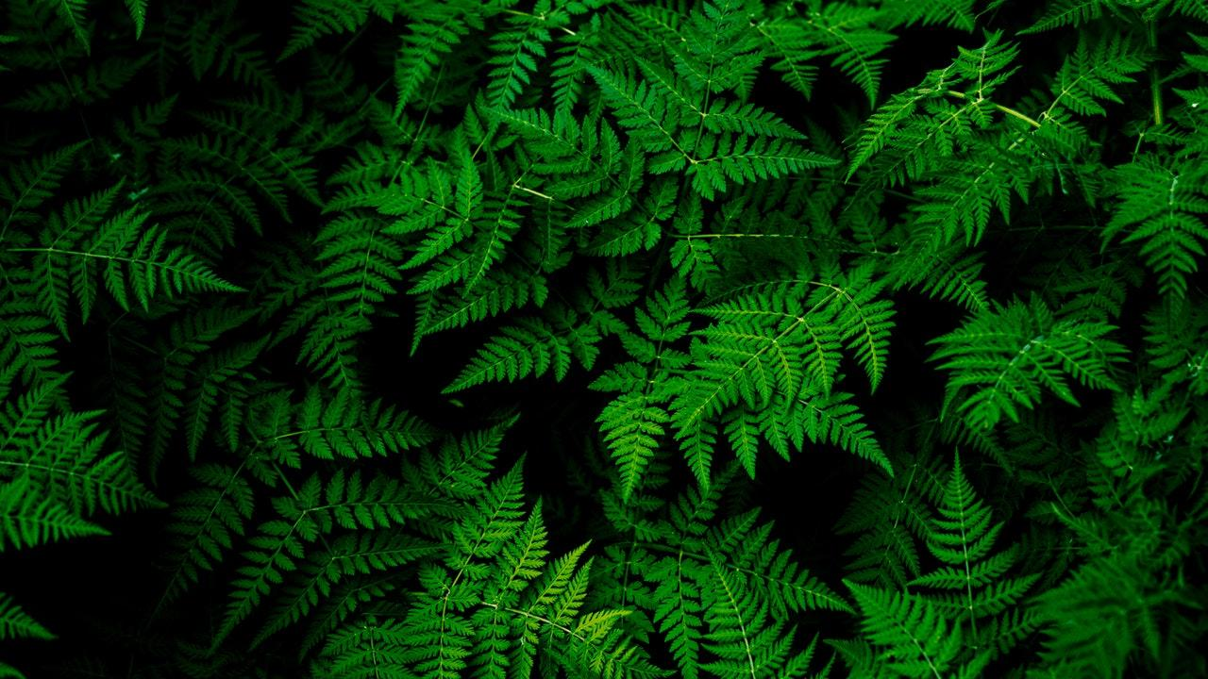
1.
What is Kishan Bandhu?

Slide 4
In two or three columns
Yellow
Is the color of gold, butter and ripe lemons. In the spectrum of visible light, yellow is found between green and orange.
Blue
Is the colour of the clear sky and the deep sea. It is located between violet and green on the optical spectrum.
Red
Is the color of blood, and because of this it has historically been associated with sacrifice, danger and courage.

Slide 5
2.
Benefits

Slide 6
Benefits:
Farmers can have their desired land.
Farmers can lease/buy machinery.
Easy transaction between stake holders.

Slide 7
BIG CONCEPT
Bring the attention of your audience over a key concept using icons or illustrations

Slide 8
3.
Usability

Slide 9
4.
Technology Stack

Slide 10
Technology stack
Frontend
HTML 5 – To design the website
CSS 3 – Style the website
Bootstrap 4 – Making website responsive
JS – Adding dynamics to website.
Jquery – HTML DOM, css animation, event handling
Backend
PHP – For all server-side scripting

Slide 11
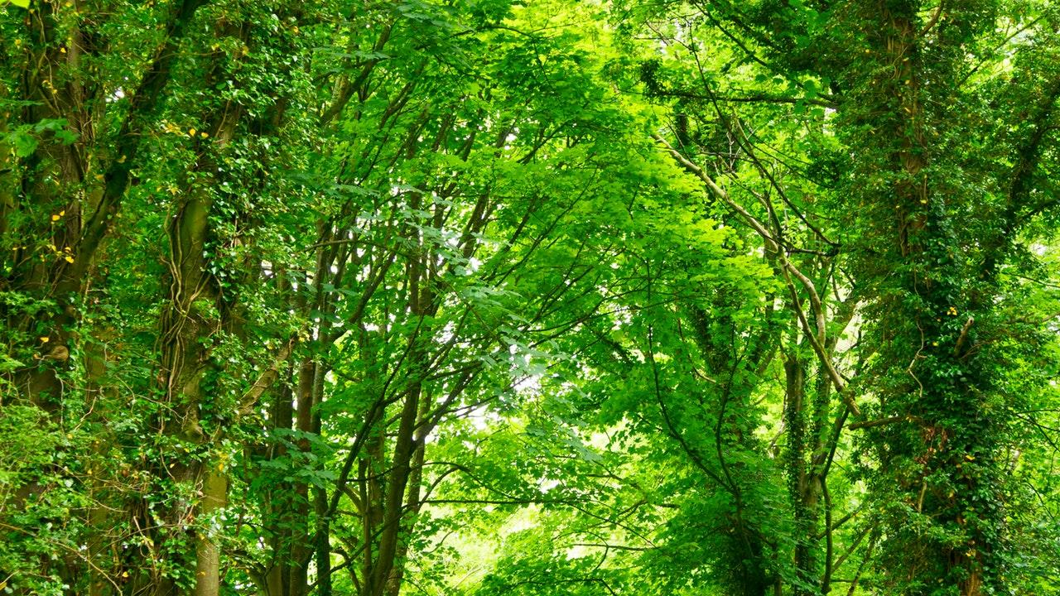
Technology stack
Database
MySql – For relational database queries
Version Control
Git – For distributed version-control system for tracking changes in source code during website development.
Hosting
Amazon Web Service(EC2 instance) – For deploying a virtual machine along with server for hosting.

Slide 12
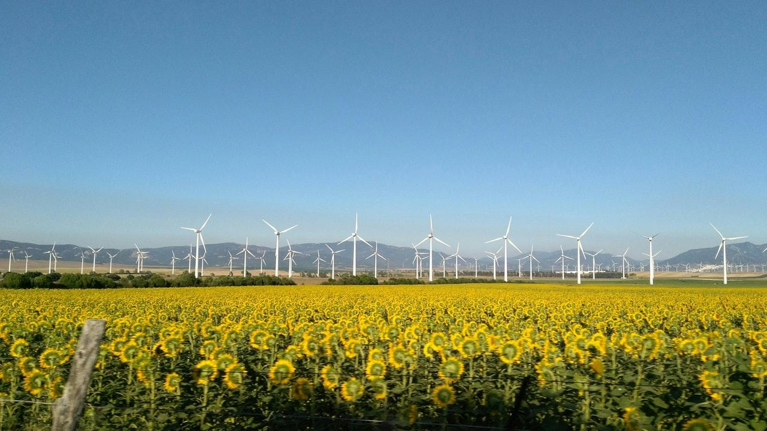
A picture is worth a thousand words
A complex idea can be conveyed with just a single still image, namely making it possible to absorb large amounts of data quickly.

Slide 13
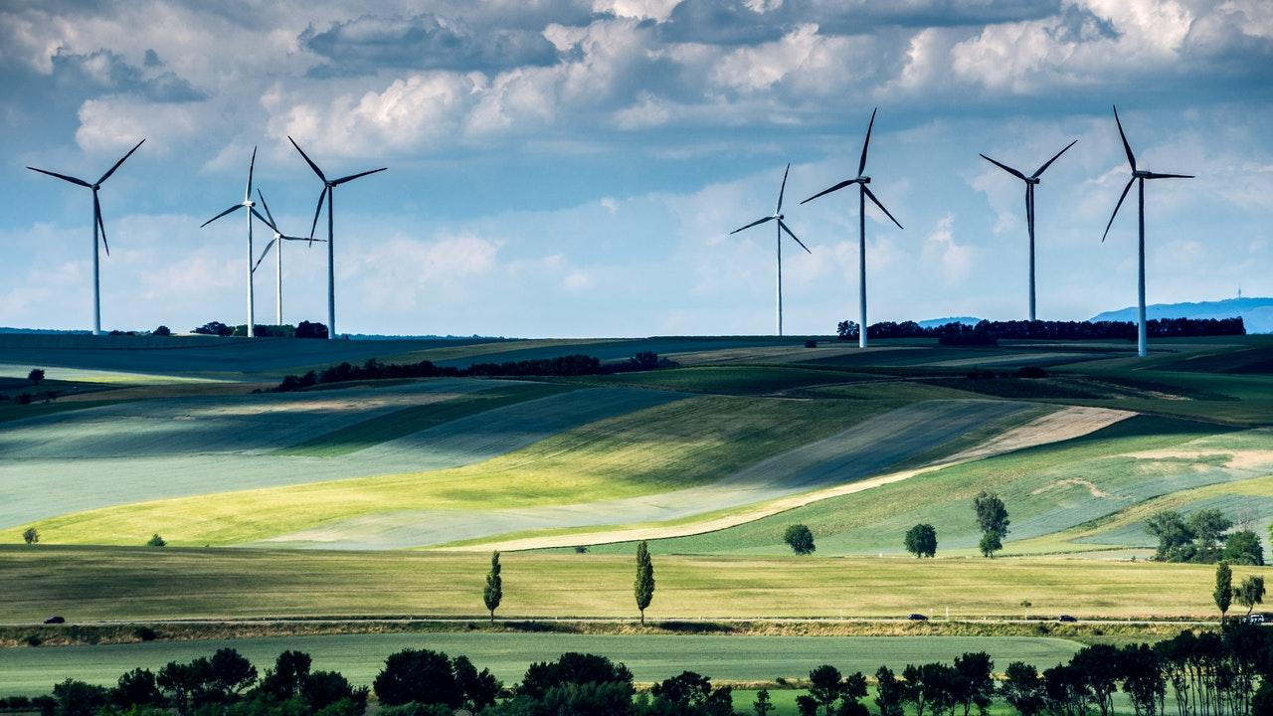
Want big impact? Use big image.

Slide 14
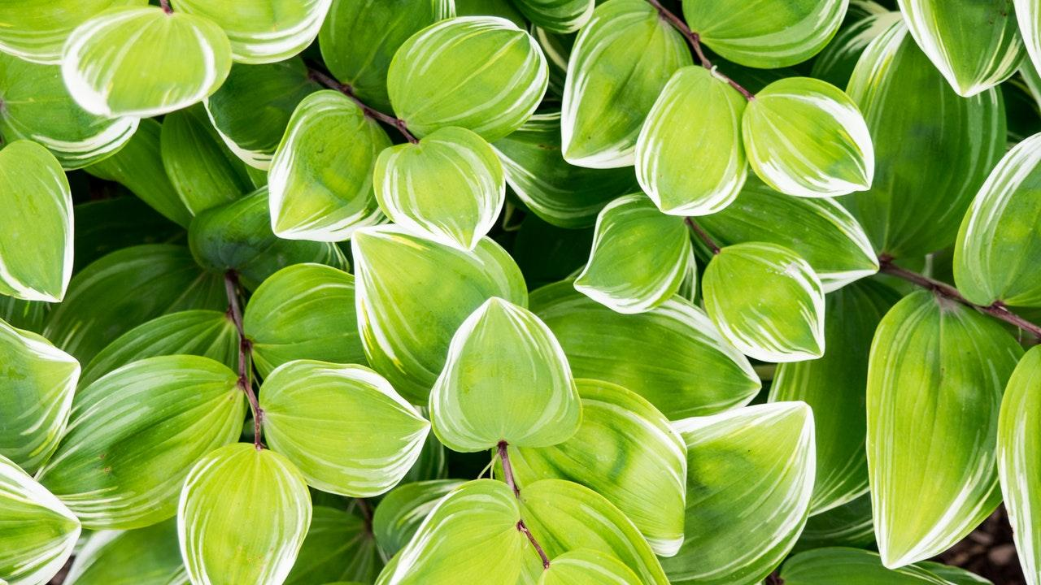
Use diagrams to explain your ideas
Vestibulum congue
Vestibulum congue
Vestibulum congue

Slide 15
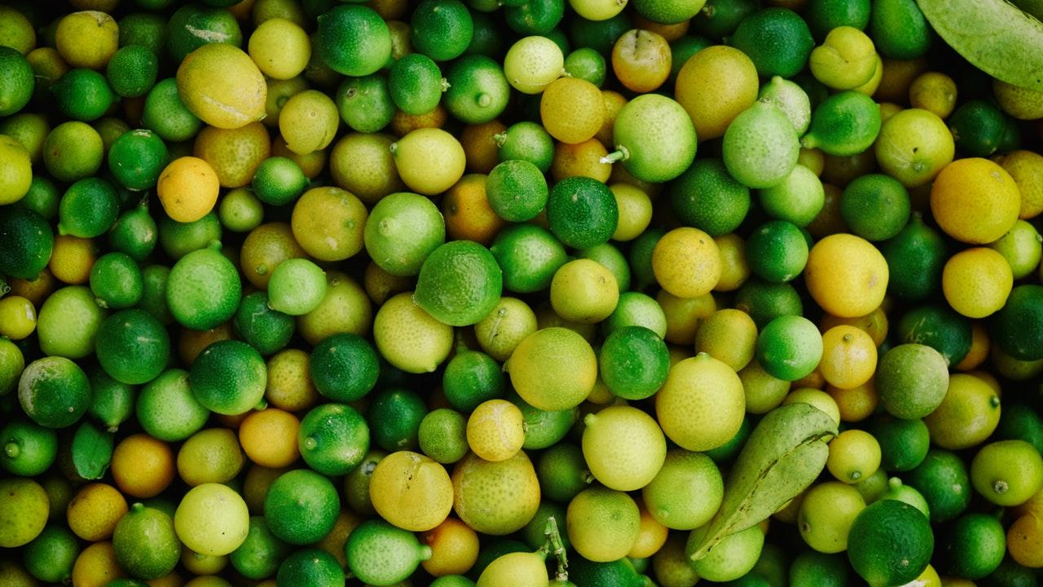
And tables to compare data
 | A | B | C
Yellow | 10 | 20 | 7
Blue | 30 | 15 | 10
Orange | 5 | 24 | 16

Slide 16
89,526,124
Whoa! That’s a big number, aren’t you proud?

Slide 17
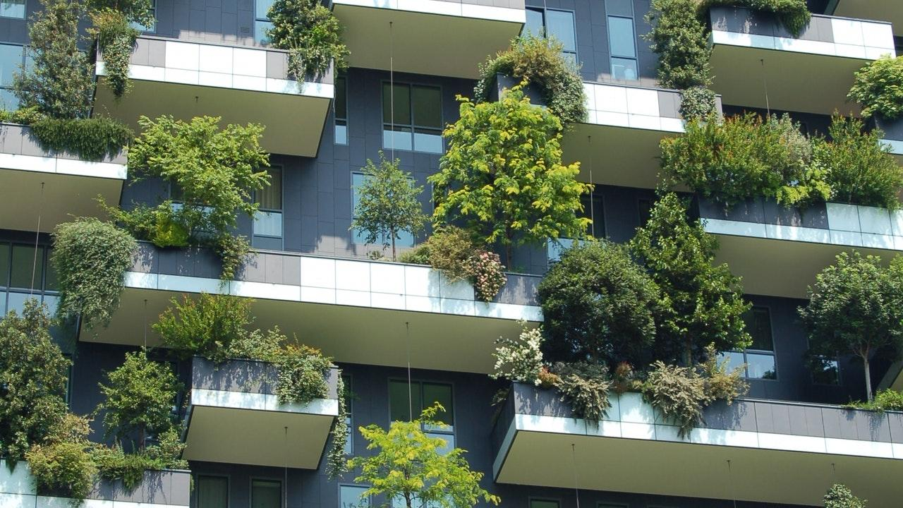
89,526,124$
185,244 users
100%
That’s a lot of money
And a lot of users
Total success!

Slide 18
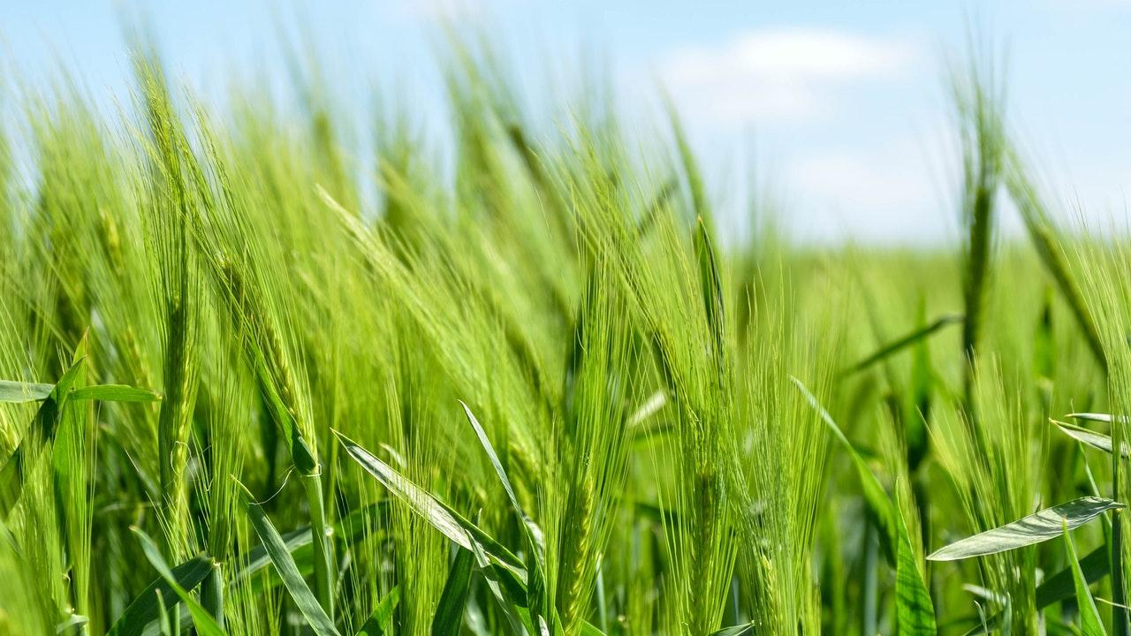
Our process is easy
Vestibulum congue tempus
Vestibulum congue tempus
03
01
02
Vestibulum congue tempus

Slide 19
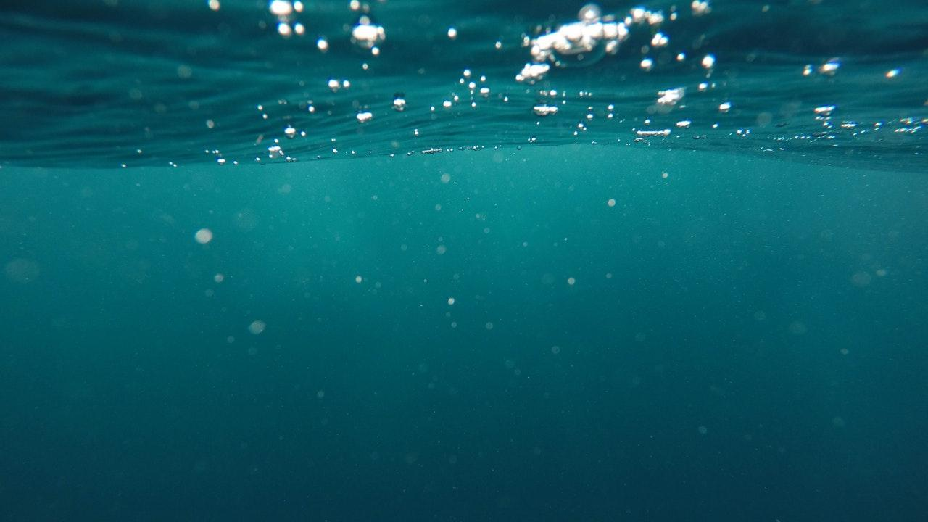
Let’s review some concepts
Yellow
Is the color of gold, butter and ripe lemons. In the spectrum of visible light, yellow is found between green and orange.
Blue
Is the colour of the clear sky and the deep sea. It is located between violet and green on the optical spectrum.
Red
Is the color of blood, and because of this it has historically been associated with sacrifice, danger and courage.
Yellow
Is the color of gold, butter and ripe lemons. In the spectrum of visible light, yellow is found between green and orange.
Blue
Is the colour of the clear sky and the deep sea. It is located between violet and green on the optical spectrum.
Red
Is the color of blood, and because of this it has historically been associated with sacrifice, danger and courage.

Slide 20
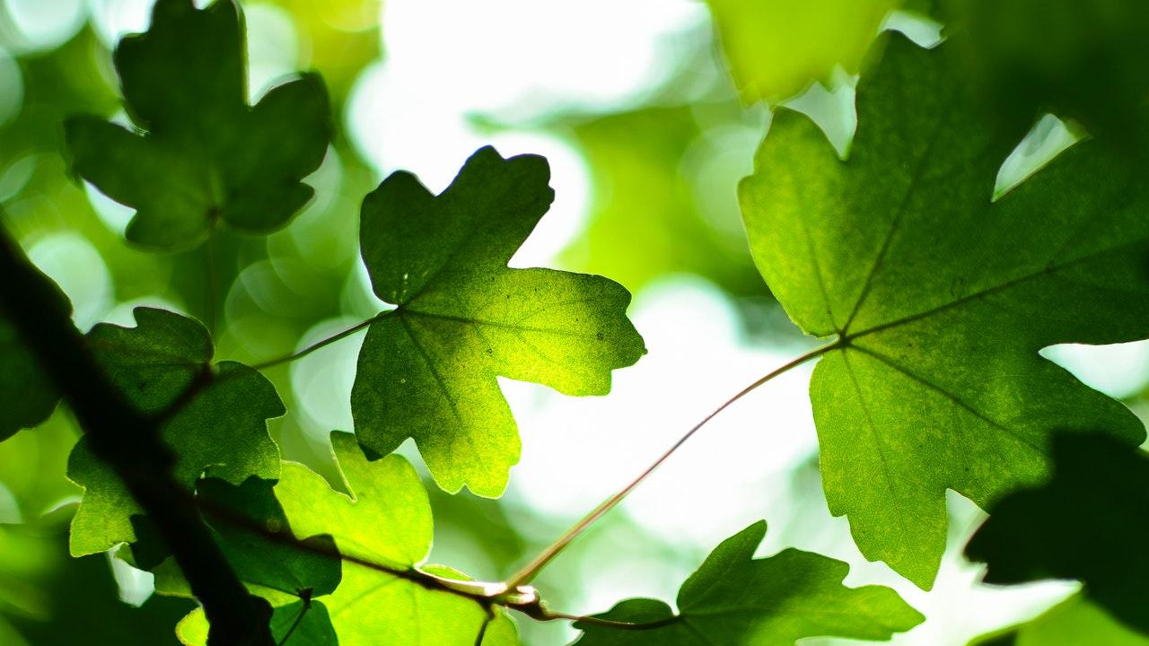
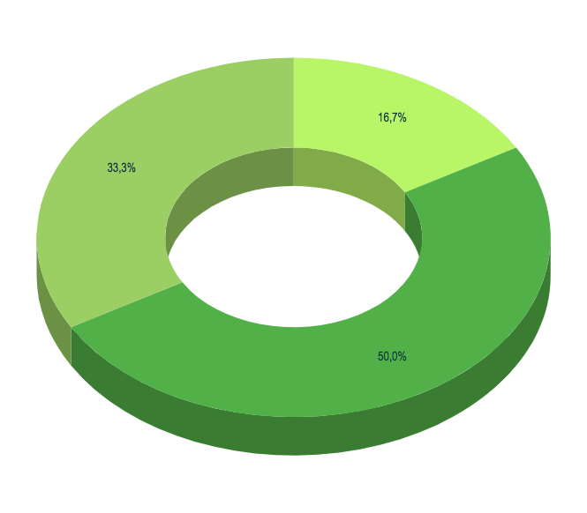
You can insert graphs from Google Sheets

Slide 22
Desktop project
Show and explain your web, app or software projects using these gadget templates.
Place your screenshot here

Slide 23
Thanks!
ANY QUESTIONS?
You can find us at
http://13.233140.202/KishanBandhu

Slide 24
Presentation design
This presentation uses the following typographies and colors:
Titles: Dosis
Body copy: Pontano Sans
You can download the fonts on these pages:
https://www.fontsquirrel.com/fonts/dosis
http://www.1001fonts.com/pontano-sans-font.html
Lime green #b8f567 Leaf green #9bcf63 Moss green #51b148
You don’t need to keep this slide in your presentation. It’s only here to serve you as a design guide if you need to create new slides or download the fonts to edit the presentation in PowerPoint®

Slide 25
SlidesCarnival icons are editable shapes.
This means that you can:
Resize them without losing quality.
Change fill color and opacity.
Change line color, width and style.
Isn’t that nice? :)
Examples:

Slide 26
😉
Now you can use any emoji as an icon!
And of course it resizes without losing quality and you can change the color.
How? Follow Google instructions https://twitter.com/googledocs/status/730087240156643328
✋👆👉👍👤👦👧👨👩👪💃🏃💑❤😂😉😋😒😭👶😸🐟🍒🍔💣📌📖🔨🎃🎈🎨🏈🏰🌏🔌🔑 and many more...

